Slide 1
Project Presentation IST 722 – Data Warehouse
GROUP 4
Aarti Anandkumar Mehra
Lekhith Reddy Kambham
Neha Sunil Patil
Sandeep Kanaram Parmar

Slide 2
Project Overview/ Goals
Create a Data Warehouse and Business Intelligence (BW/BI) program for FudgeMart, Inc.
Analyze the Sales business process across the FudgeMart, Inc based on time intervals, product categories etc.
Identify actionable insights after identifying the business trends which will improve the Sales across the organizaton.

Slide 3
About Fudge Mart Dataset
Fudgemart is a fictitious online retailer akin to industry giants like Amazon and Walmart.
Its database houses a rich array of customers, products, and vendors.
Boasts familiar e-commerce business processes, mirroring those of prominent online retailers.

Slide 4
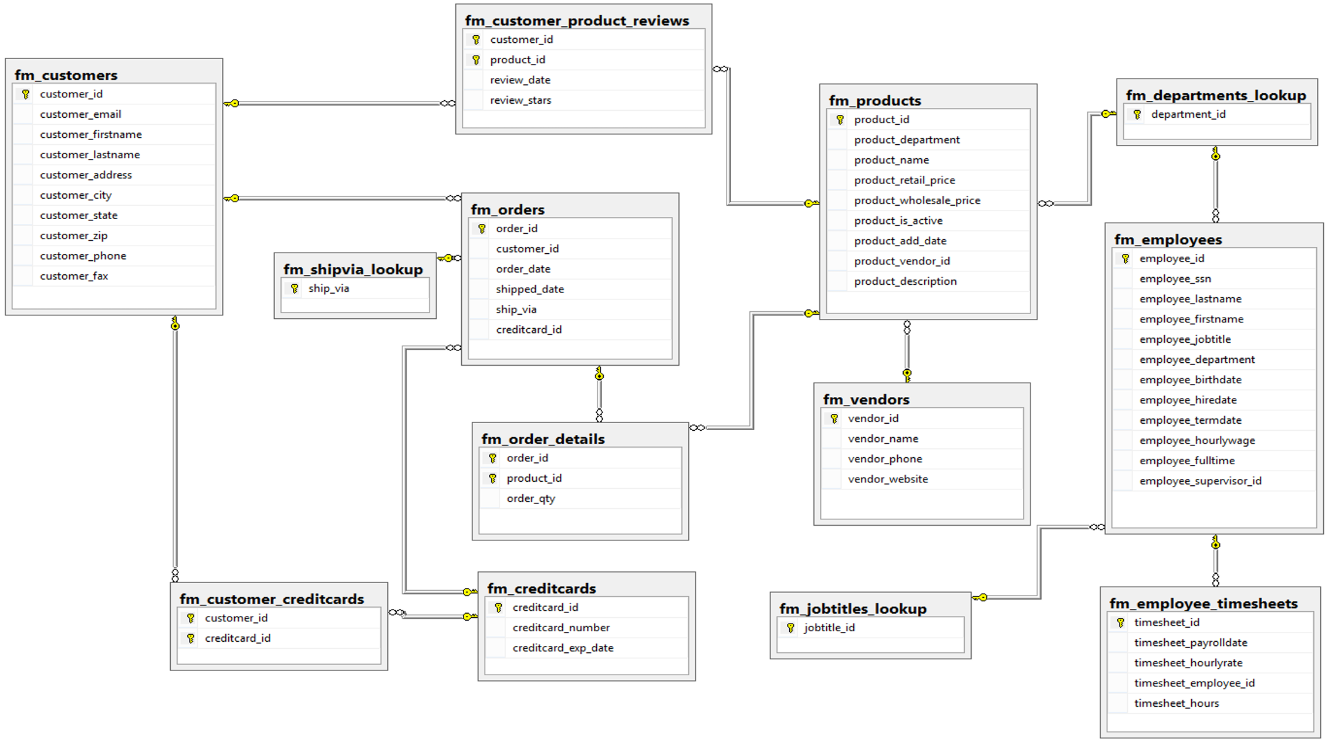
FudgeMart Schema

Slide 5

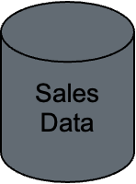
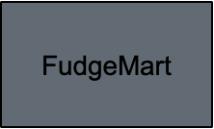

Project Flow
ETL for Fudgemart to create Sales Data Mart

Slide 6

Demo

Slide 7
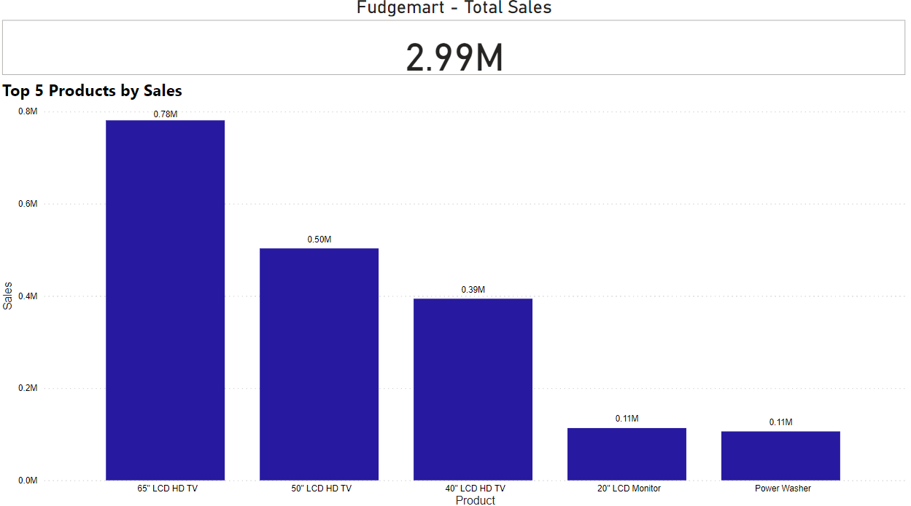
Top Five Products by Sales

Slide 8
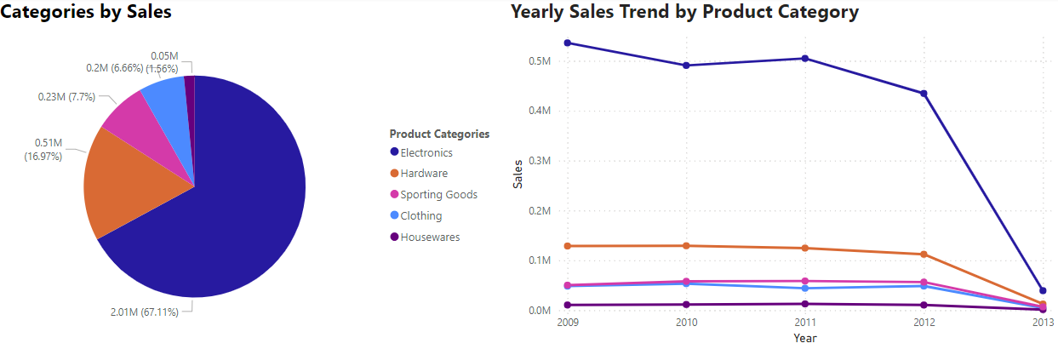
Sales Trend across Product Category

Slide 9
Recommendations
Fudgemart strategically focuses on securing exclusive electronics distribution agreements/contracts to ensure sole availability through their retail platform, thereby enhancing sales and maintaining high standards of customer service.
Carefully curate the housewares product assortment based on market research and customer feedback. Prioritize houseware items that align with current trends and customer preferences.

Slide 10
Project Roster
Name | Work
Aarti | Dimensional Modeling, loading data into Snowflake, creating BI Dashboards
Lekhith | Data Warehouse implementation, ETL Processing
Neha | Creating Bus Matrix, Documentation and Presentation
Sandeep | Data Warehouse Implementation, ETL Processing

Slide 11

Thank you

